Slide 1
Bloom/glow effect
Advanced Graphics Programming

Slide 2
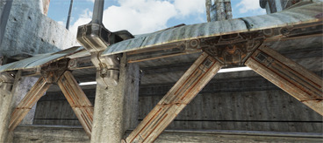
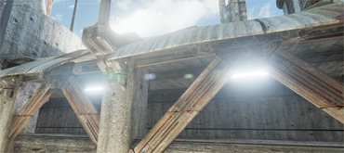
Bloom/glow effect
Without bloom
With bloom

Slide 3

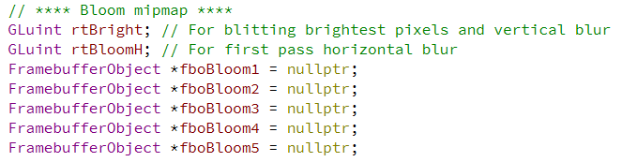
Required resources

Slide 4
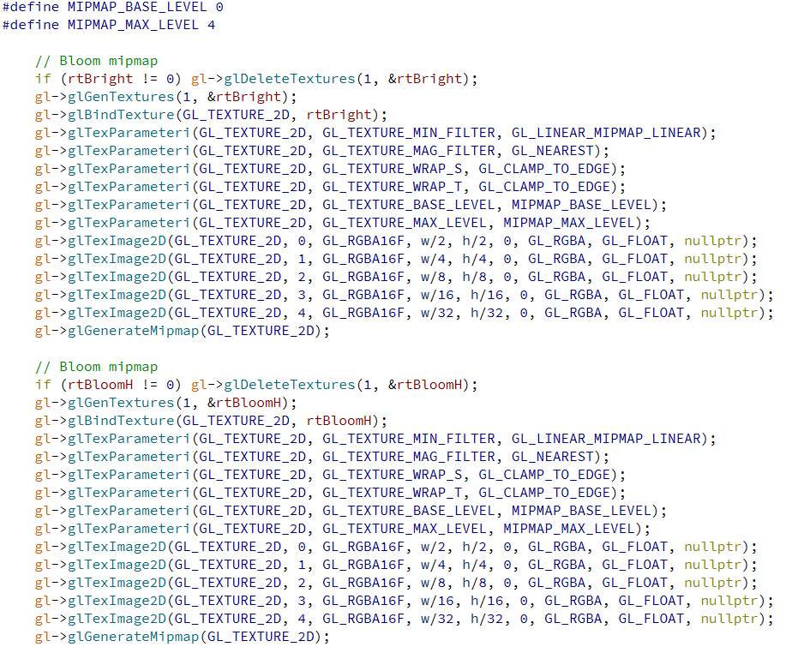
Resource initialization (mipmap textures)

Slide 5
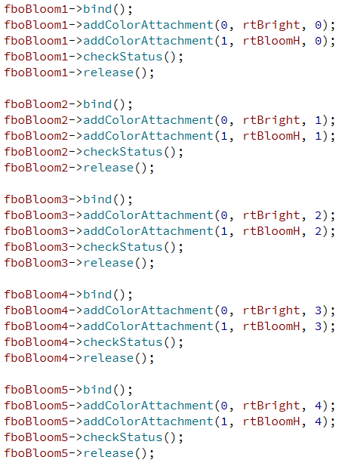
Resource initialization (bloom FBOs)

Slide 6
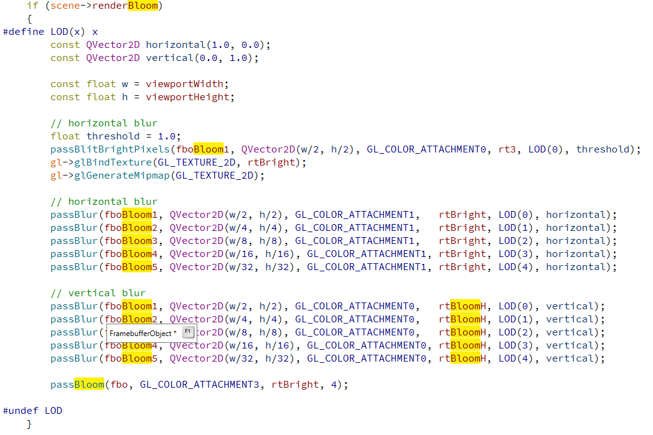
Bloom pipeline

Slide 7
Bloom pipeline
1

Slide 8
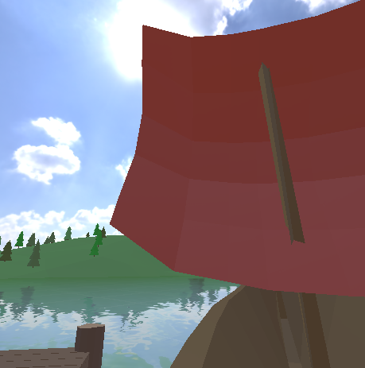
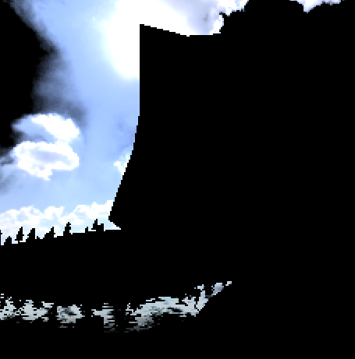
Initial blit with the brightest pixels
In texture: rt3
Out texture: rtBright
Resolution is a quarter of rt3! (width/2, height/2)

Slide 9
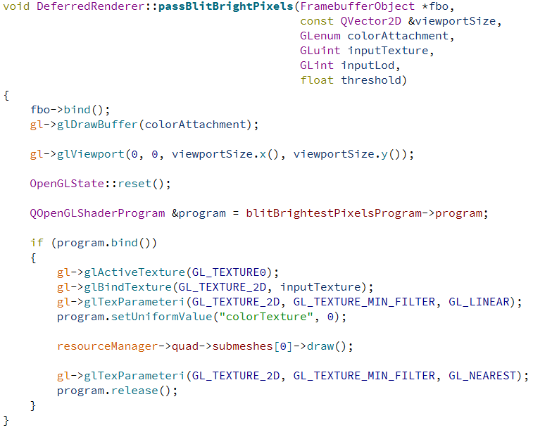
Initial blit with the brightest pixels
inputTexture
Output texture
(attached to fbo)

Slide 10
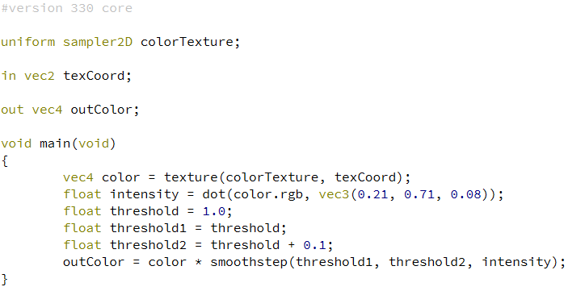
Initial blit with the brightest pixels (fragment shader)
inputTexture
Output texture
(attached to fbo)

Slide 11
Bloom pipeline
2

Slide 12




Mipmap generation
rtBright
rtBright is a mipmap with several levels of detail (LOD)
Each subsequent LOD resolution is a quarter of the previous

Slide 13
Bloom pipeline
3

Slide 14





Horizontal blur
fboBloom1
fboBloom2
fboBloom3
fboBloom4
fboBloom5
Attachment 0
rtBright
Attachment 1
rtBloomH

Slide 15
Bloom pipeline
4

Slide 16





Vertical blur
fboBloom1
fboBloom2
fboBloom3
fboBloom4
fboBloom5
Attachment 1
rtBloomH
Attachment 0
rtBright

Slide 17
The whole blur process (overview)
fboBloom1
fboBloom2
fboBloom3
fboBloom4
fboBloom5
Attachment 0
rtBright
Attachment 1
rtBloomH
Attachment 0
rtBright

Slide 18
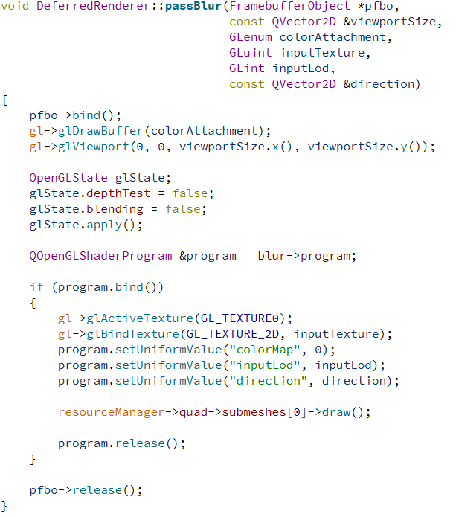
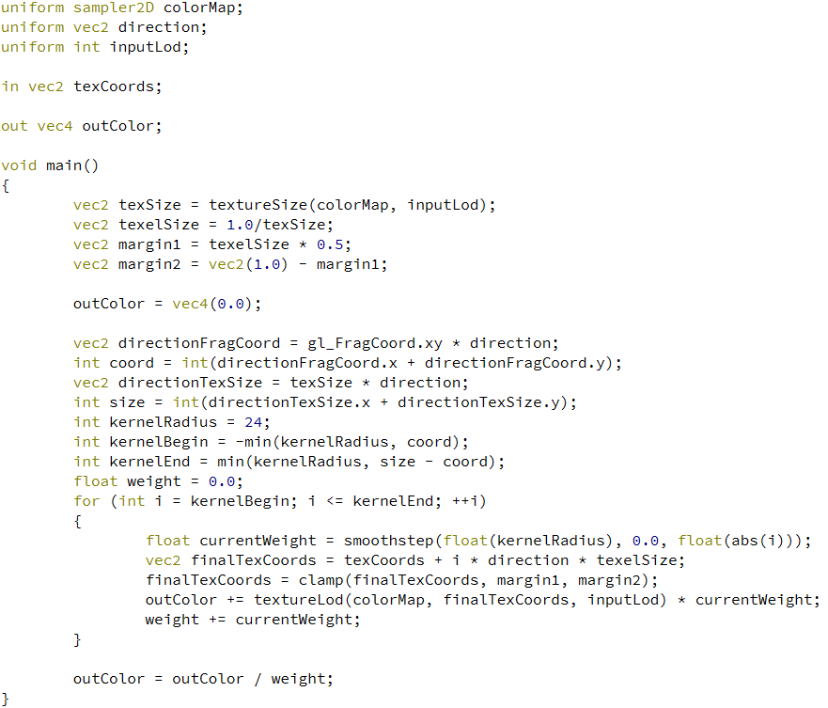
Blur in one direction (function and fragment shader)

Slide 19
Bloom pipeline
5

Slide 20
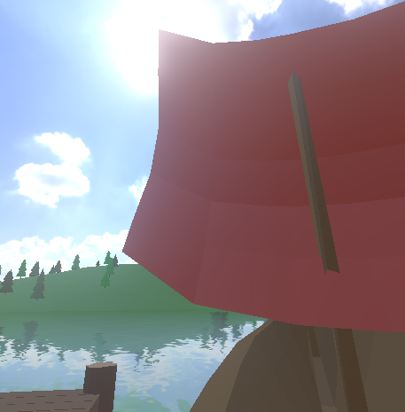
Applying bloom on the final image
rtBright LOD 0
rtBright LOD 1
rtBright LOD 2
rtBright LOD 3
rtBright LOD 4
x
intensity factor 0
x
intensity factor 1
x
intensity factor 2
x
intensity factor 3
x
intensity factor 4
Additive blending onto the final image
rt3 before
rt3 after

Slide 21
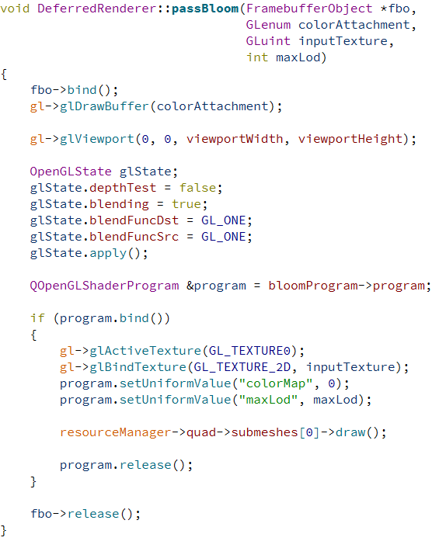
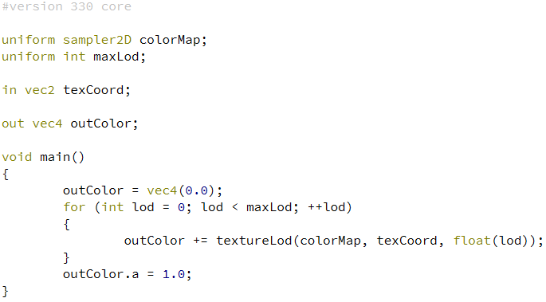
Applying bloom on the final image (function and fragment shader)

Slide 22
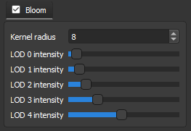
Bloom fine tuning
Some controls in the misc settings would be ideal
Enable/disable effect
Kernel radius for the blur
Intensity value for each LOD
Control amount of brightness

Slide 23
Results

Slide 24
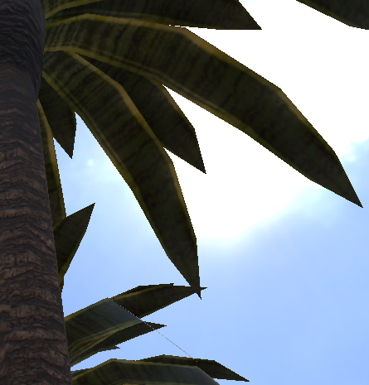
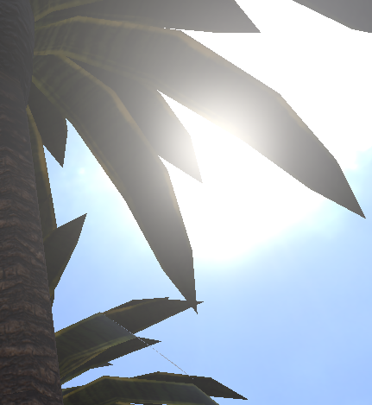
Results

Slide 25
References
Basic bloom effect:
https://learnopengl.com/Advanced-Lighting/Bloom
Thread about bloom:
https://stackoverflow.com/questions/30419153/hdr-bloom-effect-rendering-pipeline-using-opengl-glsl
Post about multiresolution bloom:
https://chrismdp.com/2015/06/how-to-quickly-add-bloom-to-your-engine/
Bloom configuration parameters in Unreal Engine:
https://docs.unrealengine.com/en-US/Engine/Rendering/PostProcessEffects/Bloom/index.html

Slide 26

Questions?

